Slide 2
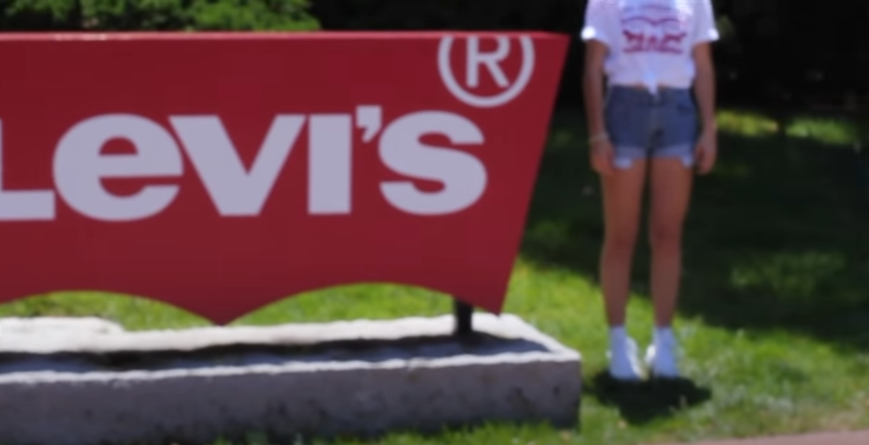

Slide 4
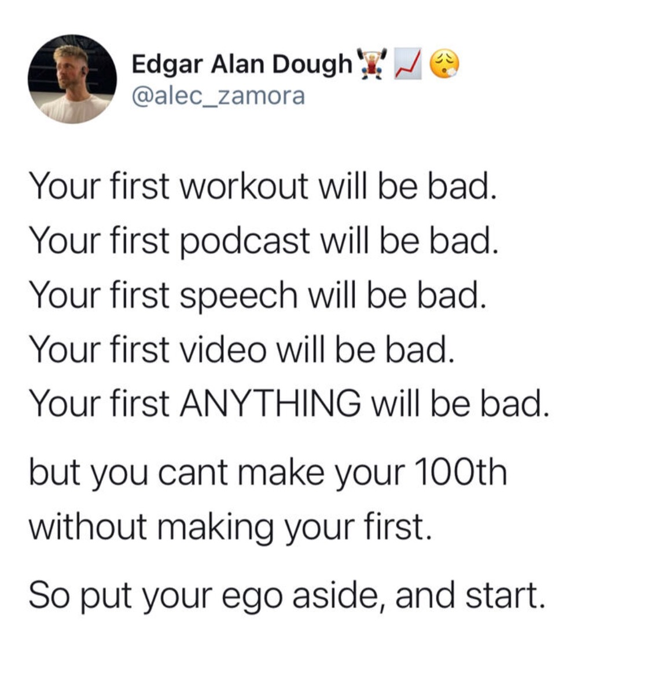

Slide 5
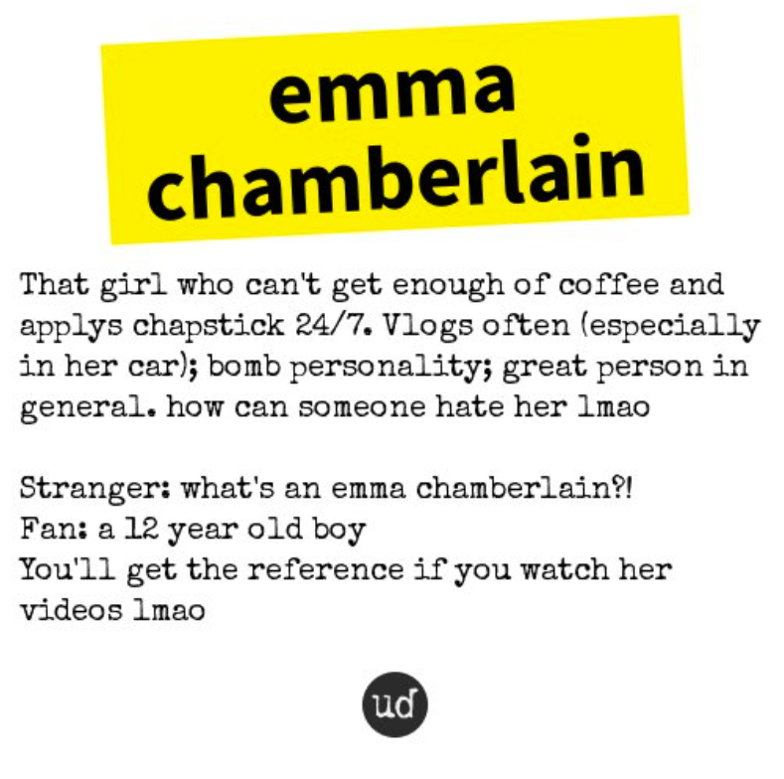
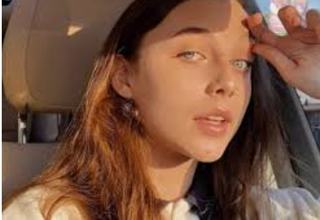
Personality
https://twitter.com/urbandictionary/status/1014711235349241857/photo/1
https://www.pinterest.com/pin/661114420289481713/

Slide 6
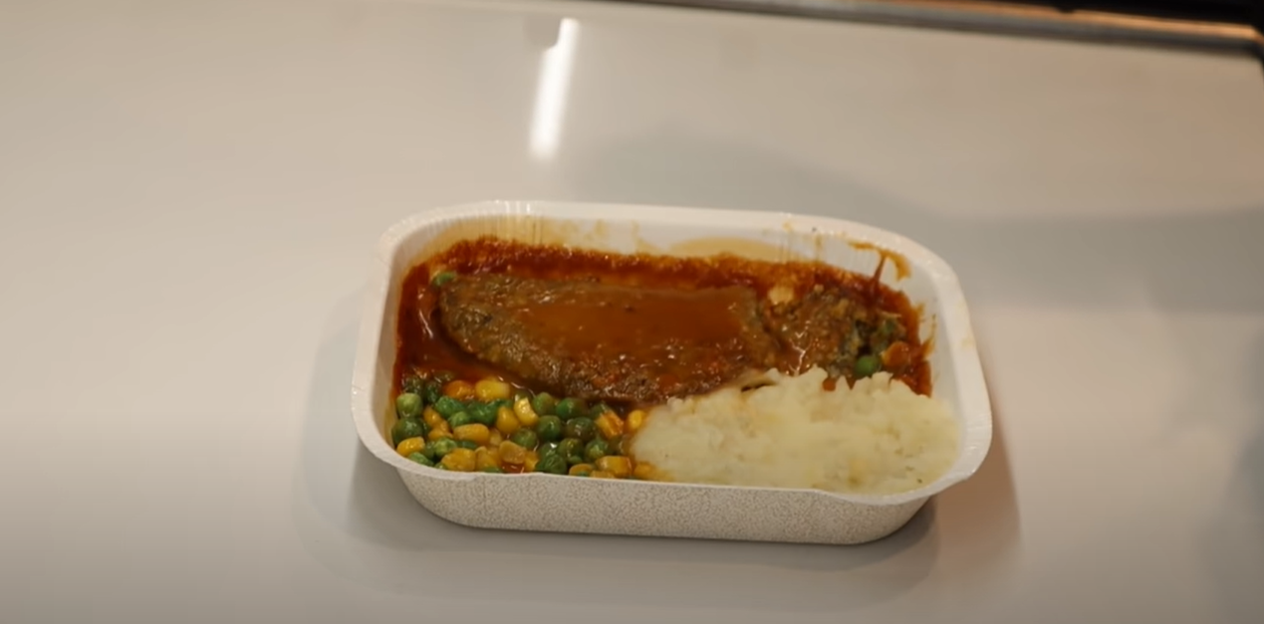
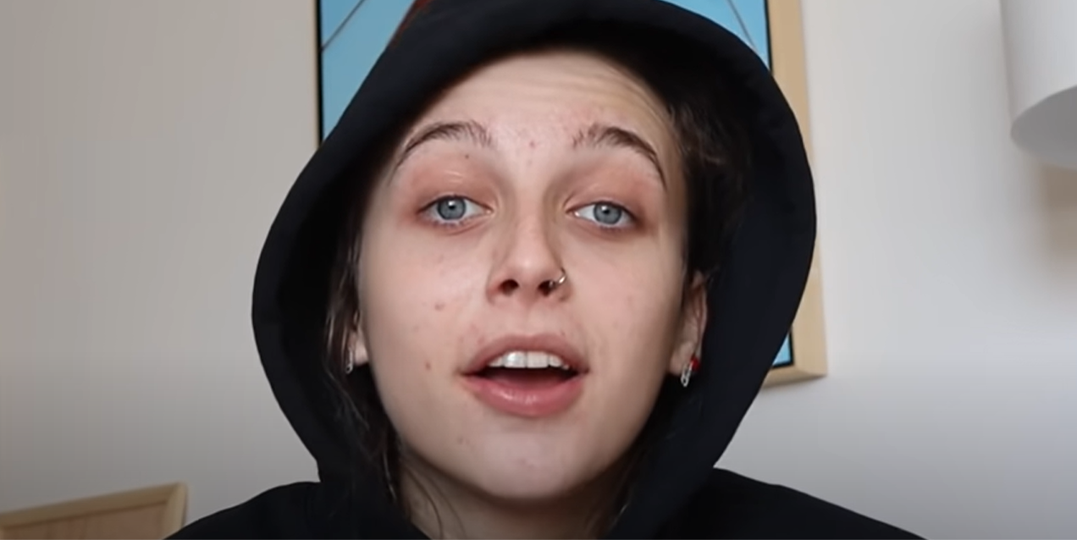
Consistency
“RECREATING THE VIDEOS I WATCHED WHILE I WAS SICK” (May 30, 2019)

Slide 7
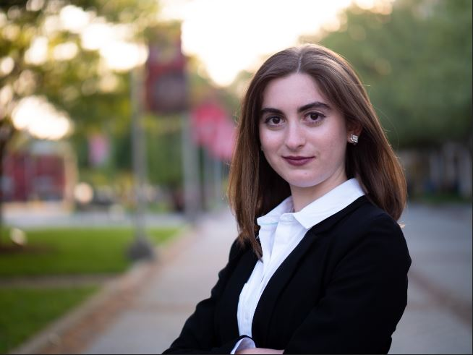
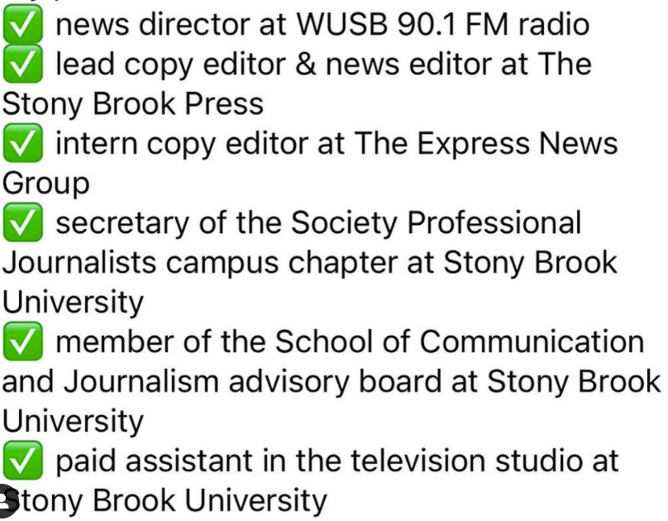
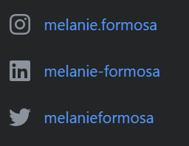
My positions this semester:
MELANIE FORMOSA ‘22
B.A. in Journalism | minor in Environmental Humanities
Producer of “Tuesdays with Melanie: The Comeback Podcast”
Check out these organizations’ social media pages! SB Engaged shows GBM times and dates.

Slide 8
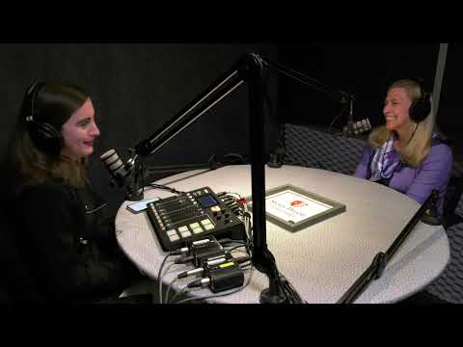
The Comeback Podcast
My YouTube channel, “Melanie Formosa” https://www.youtube.com/channel/UCG_t6ubX_qZSg8wkaIMj8jg

Slide 9
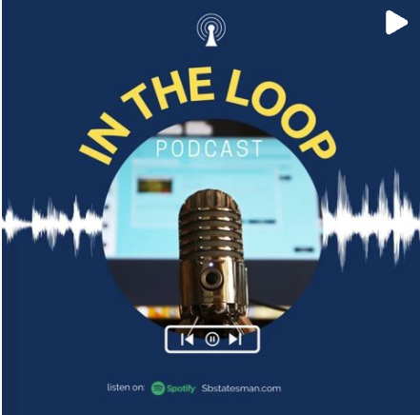
Podcast outlets and resources here on campus:
WUSB
@stonybrookwusb
The Statesman
@sbstatesman
ECC Building
School of Communication and Journalism
@sbujournalism
WSHU
@wshupublicradio
SBU-TV
@sbutv
You can get involved with “In the Loop” podcast.
The “Higher Ground” podcast is to listen and learn.

Slide 10
Hindsight is 20/20
Don’t be afraid! You’re not as bad as you think you are
And even if you are, you will improve! Believe me.
Be prepared to spend time
This is time-consuming. You’re building your brand and putting your face out there. Make sure you proofread your posts and make yourself presentable (attire, etc) > neatness goes a long way!
Social media is your friend
It’s free advertising! Make professional accounts and stay on top of them
Post everything you are doing professionally. It’s like a virtual resume!
What would you listen to?
Look at your own habits. Who do you enjoy watching? What time of day is reserved for your favorite relaxing YouTuber/podcaster? How about a peppy one? Or maybe it always changes?
Factor these into your podcast style. Avoid being boring!

Slide 11
Hindsight is 20/20
Yes, I have 14 subscribers. It doesn’t phase me. I still put my best effort in.
Don’t be embarrassed about starting out small. You’re doing this for you.
Once you know what you want to focus your podcast on, appeal to the top!
I knew the president of Stony Brook University would be a fantastic contribution to my podcast. I reached out (professionally, of course) and had her on my show
Reaching out: make sure you know how to write emails professionally! Try adding a signature highlighting your status and any positions. Get a good profile shot! (And have it uniform across all platforms)
Professors and mentors are here to help you succeed. It’s their job. Just ask!
People are always watching. If you are genuinely interested and ambitious, people will gravitate towards you! Opportunities will come! Seize every opportunity you can, however small. It will open doors

Slide 12
Things to do
Reach out! My email is melanie.formosa@stonybrook.edu
Connect with me on social media
Subscribe to my YouTube channel!
Look into WUSB, The Statesman, ECC Building, School of Communication and Journalism, WSHU, SBU-TV
My YouTube channel
~ Melanie Formosa ~ https://www.youtube.com/channel/UCG_t6ubX_qZSg8wkaIMj8jg

